Slide 1


An analysis of advanced stats, success metrics, and their correlation to wins in the 2019-20 NCAA Basketball season.
By Frederic Randall

Slide 2
Objectives
The objectives of this project are to gain insight as to what metrics can be ascribed to wins in basketball.
The depth of competition in college basketball provides us with a mountain of valuable data by which we can conduct statistical analyses
A clearer understanding of metrics that are strongly correlated with winning will be valuable to the 70 million people who fill out brackets during march each year.
The Four Factors are a good place to start our investigation.

Slide 3
The Four Factors
Shooting (40%)
Turnovers (25%)
Rebounding (20%)
Free Throws (15%)

Slide 4
Hypotheses
H1: The advanced stats associated with the Four Factors have significant correlations to wins in the 2019-20 NCAA Basketball season.
H2: The Four Factors are the strongest metrics correlated with wins in the 2019-20 NCAA Basketball Season

Slide 5
Data Sources
  For this project, I used three data sources.
  Fox Sports
  CBS Sports
  Kaggle

Slide 6
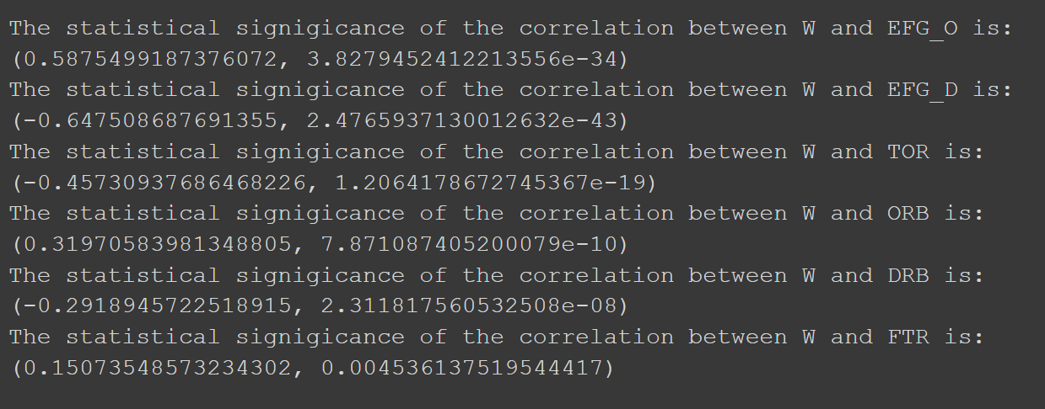
Testing
Using data from Kaggle , I ran tests in
Google Colab to measure the correlation
between games won and ther
advanced stats that constitute the
Four Factors.
Our tests showed that each statistic has a significant correlation to wins. Meaning we failed to reject our first hypothesis.
However, not every stat has as strong a correlation as expected.

Slide 7

Testing
After testing the rest of the advanced stats in our data set, I discovered other metrics that carried stronger correlations to wins than several of the four factors.
I found that three point shooting rates had a greater collective correlation to wins in the 2019-20 season than Free Throws, Rebounds, and Turnovers, allowing me to reject my second hypothesis.

Slide 8
Dashboard Planning
With a clear sense of the impactful statistics in the 2019-20 Season, I began developing a user friendly dashboard that March Madness enthusiast could use to make informed decisions while filling out their brackets.
The goal is to create a tool that allows the user to compare the key statistics correlated to winning of any two teams in the tournament. Finally, the dashboard should give the user an idea of which team has a better track record with success metrics

Slide 9
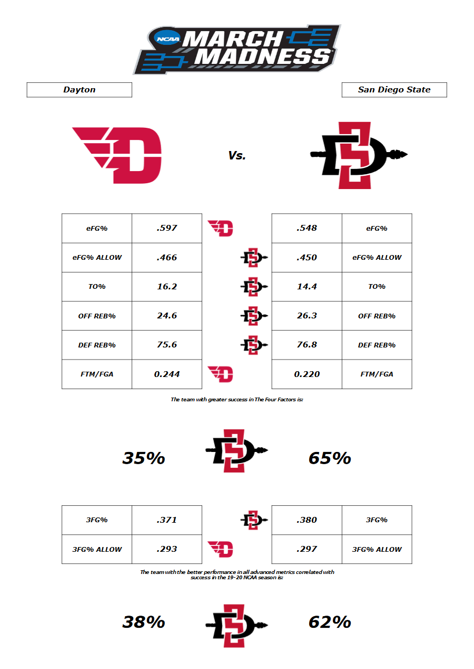
Finished Dashboard
Allows user to toggle between all the tournament teams.
Displays the team with the greater percent of success in The Four Factors.
Displays the team with the greatest percent of success in all advanced stats with significant correlation to wins.

Slide 10
As a result of my statistical analysis the correlation between wins and The Four Factors is much clearer.
Also, there are several other advanced stats to keep in mind when using data to measure a team’s success.
Lastly, the dashboard proves to give users insight into what teams will have greater success especially when pitted against other quality competitors.

